Slide 1
Stories of Faith, Hope and Love
9:26:2012

Slide 2
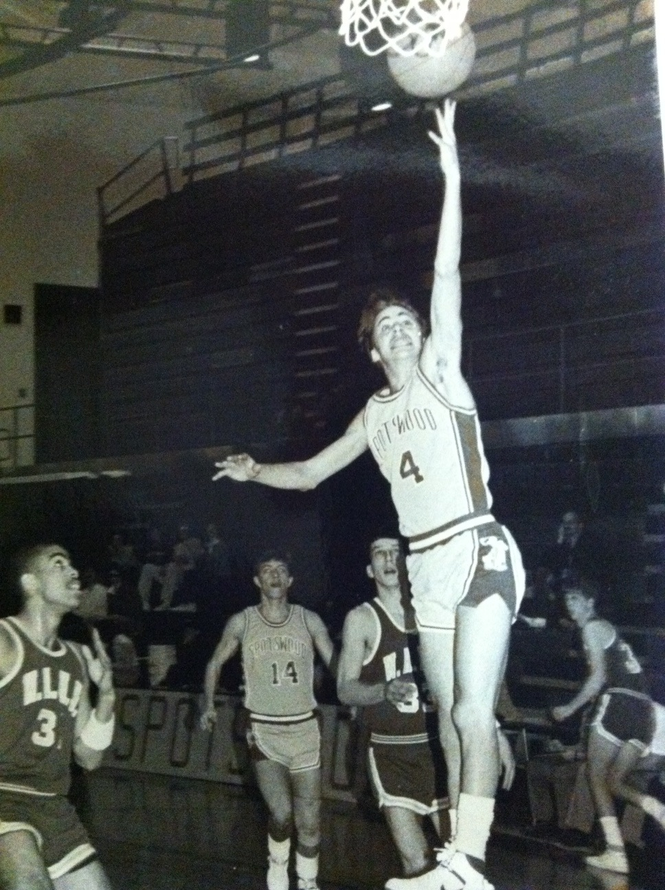

Slide 3
Eastern Nazarene College
James Madison University
Bridgewater College
Eastern Mennonite University

Slide 4
James Madison University
Bridgewater College
Eastern Mennonite University

Slide 5
Bridgewater College
Eastern Mennonite University

Slide 6
Eastern Mennonite University

Slide 7
Faith
Hebrews 11:1 – “Faith is being sure of what we hope for and certain of things we do not see.”

Slide 8
Faith debates at the “Gray House”

Slide 9
1:00am Phone Call

Slide 10
http://www.youtube.com/watch?v=F0-NPPIeeRk

Slide 11
Hope
Revelation 21:4 – “He will wipe every tear from their eyes, and there will be no more death or sorrow or crying or pain. All these things will be gone forever.”

Slide 12
Lining the soccer fields with Theo…a lesson in hope.

Slide 13
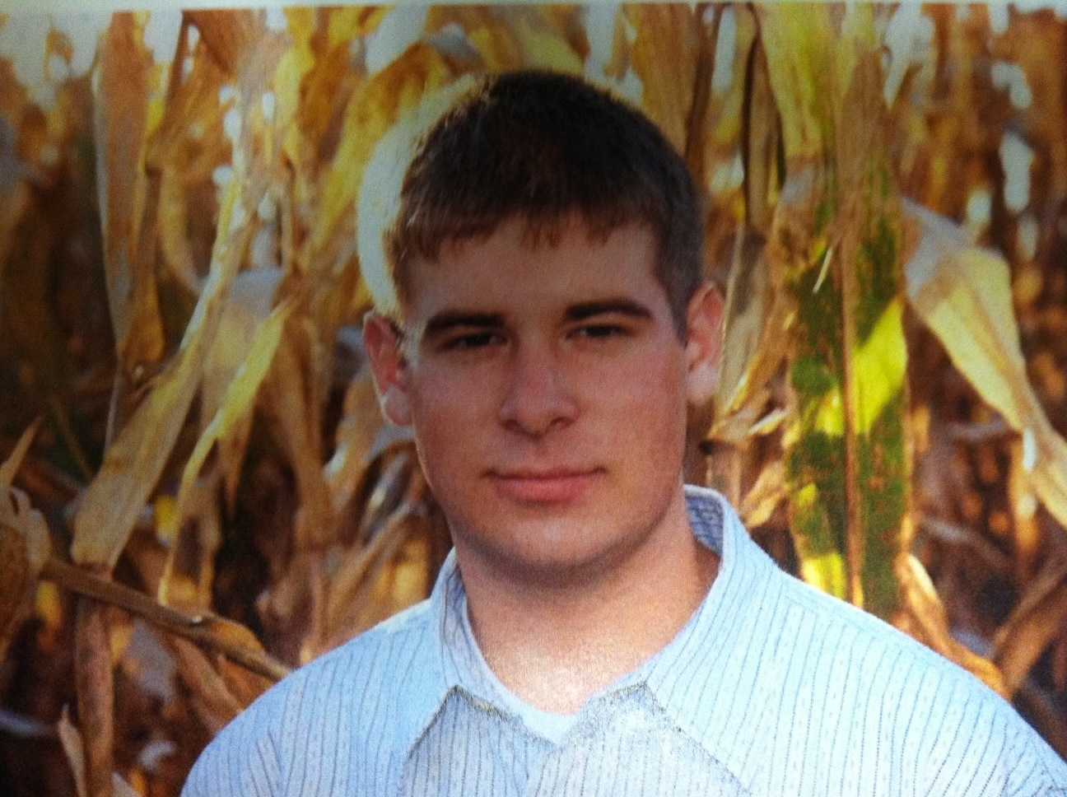

Slide 14
Love
1 Corinthians 13:13 – “And now these three remain: faith, hope and love. But the greatest of these is love.”

Slide 15
http://www.youtube.com/watch?v=nC_vXAF-pBM

